Slide 1
Secure Networks

Slide 2
Firewalls

Slide 3
Evolution of Information Systems
Centralized data processing system, with a central mainframe supporting a number of directly connected terminals.
Local area networks (LANs) interconnecting PCs and terminals to each other and the mainframe.
Premises network, consisting of a number of LANs, interconnecting PCs, servers, and perhaps a mainframe or two.
Enterprise-wide network, consisting of multiple, geographically distributed premises networks interconnected by a private wide area network (WAN).
Internet connectivity, in which the various premises networks all hook into the Internet and may or may not also be connected by a private WAN.

Slide 4
The need of firewall
Internet access provides benefits to the organization, it enables the outside world to reach and interact with local network assets
a threat to the organization
it is possible to equip each workstation and server on the premises network with strong security features
Not sufficient and Not cost effective
When a security flaw is discovered, each potentially affected system must be upgraded to fix that flaw.
scalable configuration management
A widely accepted alternative or at least complement to host-based security services is the firewall

Slide 5
Firewall Characteristics and Access Policy
All traffic from inside to outside, and vice versa, must pass through the firewall. This is achieved by physically blocking all access to the local network except via the firewall.
Only authorized traffic, as defined by the local security policy, will be allowed to pass. Various types of firewalls are used, which implement various types of security policies.
The firewall itself is immune to penetration. This implies the use of a hardened system with a secured operating system. Trusted computer systems are suitable for hosting a firewall and often required in government applications.

Slide 6
Characteristics use to filter traffic
IP Address and Protocol Values: Controls access based on the source or destination addresses and port numbers, direction of flow being inbound or outbound, and other network and transport layer characteristics.
Application Protocol: Controls access on the basis of authorized application protocol data. This type of filtering is used by an application-level gateway that relays and monitors the exchange of information for specific application protocols
User Identity: Controls access based on the users identity, typically for inside users who identify themselves using some form of secure authentication technology, such as IPSec
Network Activity: Controls access based on considerations such as the time or request, e.g., only in business hours; rate of requests, e.g., to detect scanning attempts; or other activity patterns.

Slide 7
Firewall Capabilities
A firewall defines a single choke point that attempts to keep unauthorized users out of the protected network, prohibit potentially vulnerable services from entering or leaving the network, and provide protection from various kinds of IP spoofing and routing attacks
A firewall provides a location for monitoring security-related events. Audits and alarms can be implemented on the firewall system.
A firewall is a convenient platform for several Internet functions that are not security related i.e. NAT, audit logs
A firewall can serve as the platform for IPSec.

Slide 8
Firewall Limitations
The firewall cannot protect against attacks that bypass the firewall.
The firewall may not protect fully against internal threats
An improperly secured wireless LAN may be accessed from outside the organization
A laptop, PDA, or portable storage device may be used and infected outside the corporate network and then attached and used internally.

Slide 9
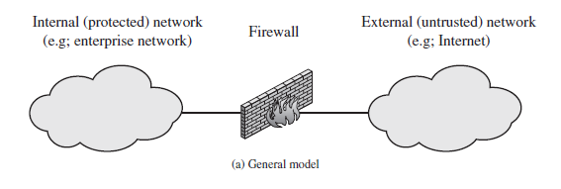
Types of Firewalls

Slide 10
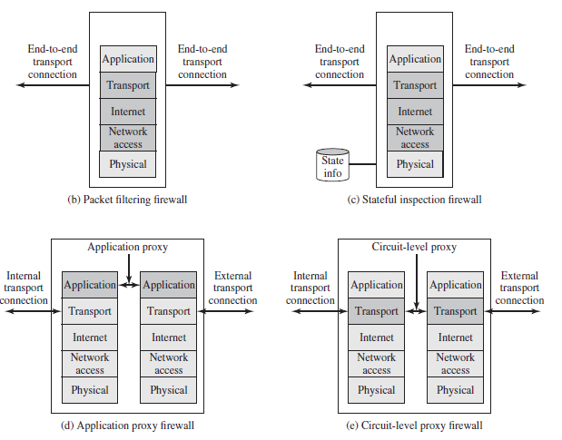
Types of Firewalls

Slide 11
Packet Filtering Firewall
A packet filtering firewall applies a set of rules to each incoming and outgoing IP packet and then forwards or discards the packet
The firewall is typically configured to filter packets going in both directions
Filtering rules are based on information contained in a network packet:
Source IP address: The IP address of the system that originated the IP packet (e.g., 192.178.1.1).
Destination IP address: The IP address of the system the IP packet is trying to reach (e.g., 192.168.1.2).
Source and destination transport-level address: The transport-level (e.g., TCP or UDP) port number, which defines applications such as SNMP or TELNET.
IP protocol field: Defines the transport protocol.
Interface: For a firewall with three or more ports, which interface of the firewall the packet came from or which interface of the firewall the packet is destined for.

Slide 12
Packet Filtering Firewall
The packet filter is typically set up as a list of rules based on matches to fields in the IP or TCP header.
If there is a match to one of the rules, that rule is invoked to determine whether to forward or discard the packet.
If there is no match to any rule, then a default action is taken Two default policies are possible:
Default = discard: That which is not expressly permitted is prohibited.
Default = forward: That which is not expressly prohibited is permitted

Slide 13
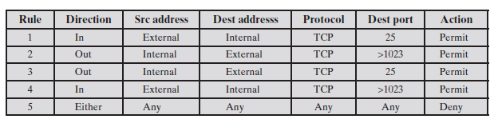
Packet Filter Firewall Rules
Notes:
1. Inbound mail from an external source is allowed (port 25 is for SMTP incoming).
2. This rule is intended to allow a response to an inbound SMTP connection.
3. Outbound mail to an external source is allowed
4. This rule is intended to allow a response to an inbound SMTP connection.
5. This is an explicit statement of the default policy. All rule sets include this rule
implicitly as the last rule.

Slide 14
Packet Filter Firewall Rules
Problem ???
Notes:
1. Inbound mail from an external source is allowed (port 25 is for SMTP incoming).
2. This rule is intended to allow a response to an inbound SMTP connection.
3. Outbound mail to an external source is allowed
4. This rule is intended to allow a response to an inbound SMTP connection.
5. This is an explicit statement of the default policy. All rule sets include this rule
implicitly as the last rule.

Slide 15
Packet Filter Firewall Rules
Problem = Rule 4 allows external traffic
to any destination port above 1023. As an example of an exploit of this rule, an
external attacker can open a connection from the attacker’s port 5150 to an internal
Web proxy server on port 8080
Notes:
1. Inbound mail from an external source is allowed (port 25 is for SMTP incoming).
2. This rule is intended to allow a response to an inbound SMTP connection.
3. Outbound mail to an external source is allowed
4. This rule is intended to allow a response to an inbound SMTP connection.
5. This is an explicit statement of the default policy. All rule sets include this rule
implicitly as the last rule.

Slide 16

Packet Filter Firewall Rules
Solution:
Notes:
1. Inbound mail from an external source is allowed (port 25 is for SMTP incoming).
2. This rule is intended to allow a response to an inbound SMTP connection.
3. Outbound mail to an external source is allowed
4. This rule is intended to allow a response to an inbound SMTP connection.
5. This is an explicit statement of the default policy. All rule sets include this rule
implicitly as the last rule.

Slide 17
Weakness of Packet Filtering Firewall
Because packet filter firewalls do not examine upper-layer data, they cannot prevent attacks that employ application-specific vulnerabilities or functions
Because of the limited information available to the firewall, the logging functionality present in packet filter firewalls is limited
Most packet filter firewalls do not support advanced user authentication schemes.
Packet filter firewalls are generally vulnerable to attacks and exploits that take advantage of problems within the TCP/IP specification and protocol stack
Packet filter firewalls are susceptible to security breaches caused by improper configurations.

Slide 18
Attacks on Packet Filtering Firewall
IP address spoofing: The intruder transmits packets from the outside with a source IP address field containing an address of an internal host. The attacker hopes that the use of a spoofed address will allow penetration of systems that employ simple source address security, in which packets from specific trusted internal hosts are accepted.
Source routing attacks: The source station specifies the route that a packet should take as it crosses the Internet, in the hopes that this will bypass security measures that do not analyze the source routing information
Tiny fragment attacks: The intruder uses the IP fragmentation option to create extremely small fragments and force the TCP header information into a separate packet fragment. This attack is designed to circumvent filtering rules that depend on TCP header information. Typically, a packet filter will make a filtering decision on the first fragment of a packet

Slide 19
Countermeasures
IP address spoofing: The countermeasure is to discard packets with an inside source address if the packet arrives on an external interface. In fact, this countermeasure is often implemented at the router external to the firewall.
Source routing attacks: A countermeasure is to discard all packets that use this option.
Tiny fragment attacks: attack can be defeated by enforcing a rule that the first fragment of a packet must contain a predefined minimum amount of the transport header. If the first fragment is rejected, the filter can remember the packet and discard all subsequent fragments.

Slide 20
Stateful packet Inspection
A traditional packet filter makes filtering decisions on an individual packet basis and does not take into consideration any higher-layer context.
A Stateful packet inspection firewall tightens up the rules for TCP traffic by creating a directory of outbound TCP connections.
The packet filter will now allow incoming traffic to high-numbered ports only for those packets that fit the profile of one of the entries in this directory.
A Stateful packet inspection firewall reviews the same packet information as a packet filtering firewall, but also records information about TCP connections
Some stateful firewalls also keep track of TCP sequence numbers to prevent attacks that depend on the sequence number, such as session hijacking. Some even inspect limited amounts of application data

Slide 21
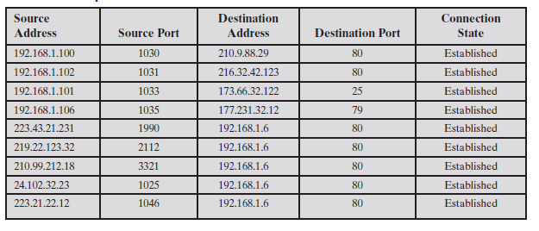
State Table

Slide 22
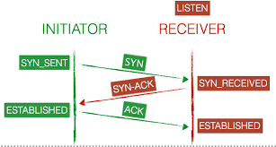
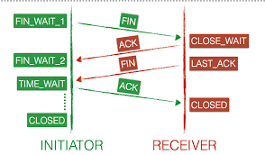
TCP states

Slide 23
Application-Level Gateway
An application-level gateway, also called an application proxy, acts as a relay of application-level traffic
The user contacts the gateway using a TCP/ IP application, such as Telnet or FTP, and the gateway asks the user for the name of the remote host to be accessed.
When the user responds and provides a valid user ID and authentication information, the gateway contacts the application on the remote host and relays TCP segments containing the application data between the two endpoints
If the gateway does not implement the proxy code for a specific application, the service is not supported and cannot be forwarded across the firewall.
Further, the gateway can be configured to support only specific features of an application that the network administrator considers acceptable while denying all other features.

Slide 24
Application-level Gateway
Application-level gateways tend to be more secure than packet filters.
Rather than trying to deal with the numerous possible combinations that are to be allowed and forbidden at the TCP and IP level, the application-level gateway need only scrutinize a few allowable applications.
In addition, it is easy to log and audit all incoming traffic at the application level.
A prime disadvantage of this type of gateway is the additional processing overhead on each connection. In effect, there are two spliced connections between the end users, with the gateway at the splice point, and the gateway must examine and forward all traffic in both directions.

Slide 25
Circuit-level Gateway
This can be a stand-alone system or it can be a specialized function performed by an application-level gateway for certain applications.
As with an application gateway, a circuit-level gateway does not permit an end-to-end TCP connection; rather, the gateway sets up two TCP connections, one between itself and a TCP user on an inner host and one between itself and a TCP user on an outside host.
Once the two connections are established, the gateway typically relays TCP segments from one connection to the other without examining the contents.
The security function consists of determining which connections will be allowed.

Slide 26
Firewall BASING

Slide 27
Bastion Host
A bastion host is a system identified by the firewall administrator as a critical strong point in the network’s security.
Typically, the bastion host serves as a platform for an application-level or circuit-level gateway
Important Characteristics
The bastion host hardware platform executes a secure version of its operating system, making it a hardened system.
Only the services that the network administrator considers essential are installed on the bastion host.
The bastion host may require additional authentication before a user is allowed access to the proxy service

Slide 28
Host based Firewall
A host-based firewall is a software module used to secure an individual host.
Such modules are available in many operating systems or can be provided as an add-on package.
Advantages
Filtering rules can be tailored to the host environment.
Protection is provided independent of topology.
Used in conjunction with stand-alone firewalls, the host-based firewall provides an additional layer of protection

Slide 29
Personal Firewall
A personal firewall controls the traffic between a personal computer or workstation on one side and the Internet or enterprise network on the other side.
Personal firewall functionality can be used in the home environment and on corporate intranets.
Typically, the personal firewall is a software module on the personal computer.
In a home environment with multiple computers connected to the Internet, firewall functionality can also be housed in a router that connects all of the home computers to a DSL, cable modem, or other Internet interface.
Personal firewalls are typically much less complex than either server-based firewalls or stand-alone firewalls.
The primary role of the personal firewall is to deny unauthorized remote access to the computer.
The firewall can also monitor outgoing activity in an attempt to detect and block worms and other malware

Slide 30
Firewall Location and Configurations

Slide 31
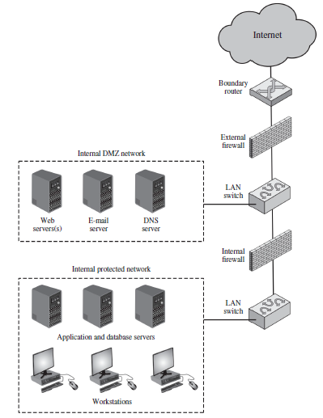
DMZ Networks
A DMZ or demilitarized zone is a perimeter network that protects and adds an extra layer of security to an organization's internal local-area network from untrusted traffic.

Slide 32
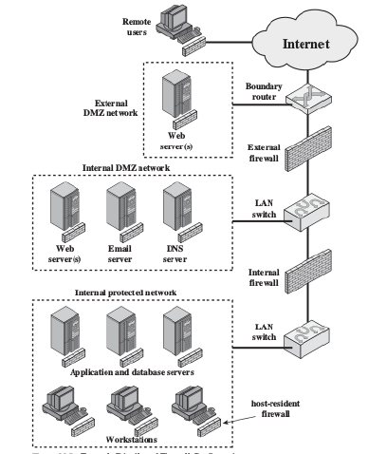
Distributed Firewalls

Slide 33
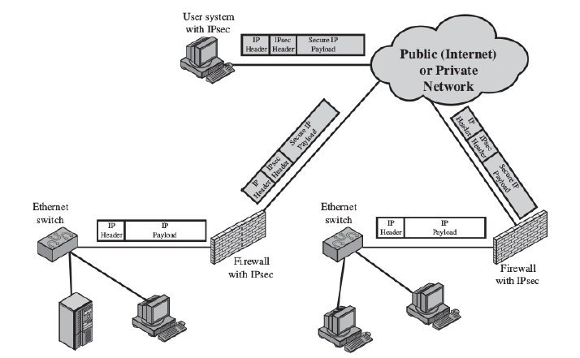
Virtual Private Network

Slide 34
Intrusion Prevention System

Slide 35
Introduction
A relatively recent addition to the terminology of security products is the intrusion prevention system (IPS). There are two complementary ways of looking at an IPS:
An IPS is an inline network-based IDS (NIDS) that has the capability to block traffic by discarding packets as well as simply detecting suspicious traffic. Alternatively, the IPS can monitor ports on a switch that receives all traffic and then send the appropriate commands to a router or firewall to block traffic. For host-based systems, an IPS is a host-based IDS that can discard incoming traffic.
An IPS is a functional addition to a firewall that adds IDS types of algorithms to the repertoire of the firewall.

Slide 36
Host based IPS
A host-based IPS (HIPS) makes use of both signature and anomaly detection techniques to identify attacks.
Examples of the types of malicious behavior addressed by a HIPS
Modification of system resources
Privilege-escalation exploits
Buffer-overflow exploits
Access to e-mail contact list
Directory traversal
Filtration is based on
System calls, File access, I/O operations and Registry Settings

Slide 37
Network based IPS
A network-based IPS (NIPS) is in essence an inline NIDS with the authority to discard packets and tear down TCP connections.
In terms of the general methods used by a NIPS device to identify malicious packets, the following are typical:
Pattern matching
Stateful matching
Protocol anomaly
Traffic anomaly
Statistical anomaly

Slide 38
X.509 Certificates
ITU-T recommendation X.509 is part of the X.500 series of recommendations that define a directory service.
X.509 defines a framework for the provision of authentication services by the X.500 directory to its users.
The directory may serve as a repository of public-key certificates
Each certificate contains the public key of a user and is signed with the private key of a trusted certification authority
X.509 is based on the use of public-key cryptography and digital signatures. The standard does not dictate the use of a specific algorithm but recommends RSA. The digital signature scheme is assumed to require the use of a hash function

Slide 39
Public Key Certificate Use

Slide 40
X.509

Slide 41
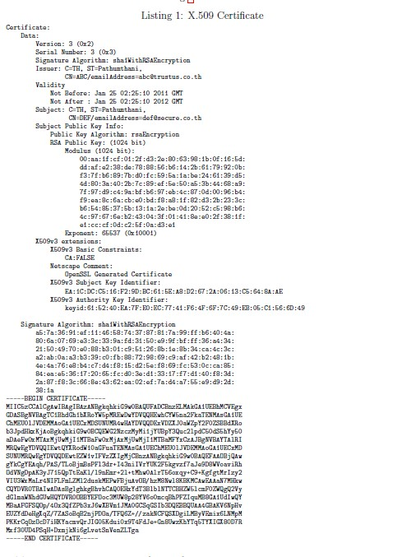

Slide 42

Whose certificate is this?
Answer. The user DEF
(b) Whose RSA key is included in the certificate?
Answer. The user DEF
(c) What are the last two hexadecimal digits of e in the users RSA key?
Answer. The exponent, e, is 65537 in decimal, or 10001 in hex. The answer is 01.
(d) What are the last two hexadecimal digits of n in the users RSA key?
Answer. The modulus, n, is given in hex and ends with e1.
In general, an X.509 certificate for user A can be expressed as:
CA = Data||S
where Data is the concatenation of the elds: Version, SerialNumber, SignatureAlgorithm, Issuer, Validity, Subject, SubjectPublicKeyInfo and X509v3extensions.
(e) Write an equation for how S is calculated in the certificate in Listing 1? You must
use the names of algorithms used in the above certificate (i.e. you cannot use E()),
as well as clearly identify which user each key belongs to. You may use the variable
Data in your equation to represent the concatenation of various elds.
Answer.

Slide 43
References
Computer Security Principles and Practice, 2nd Edition.

